Slide 1
Global_Powerplant_Data_Visualization
File created on: 19/03/2025

Slide 2
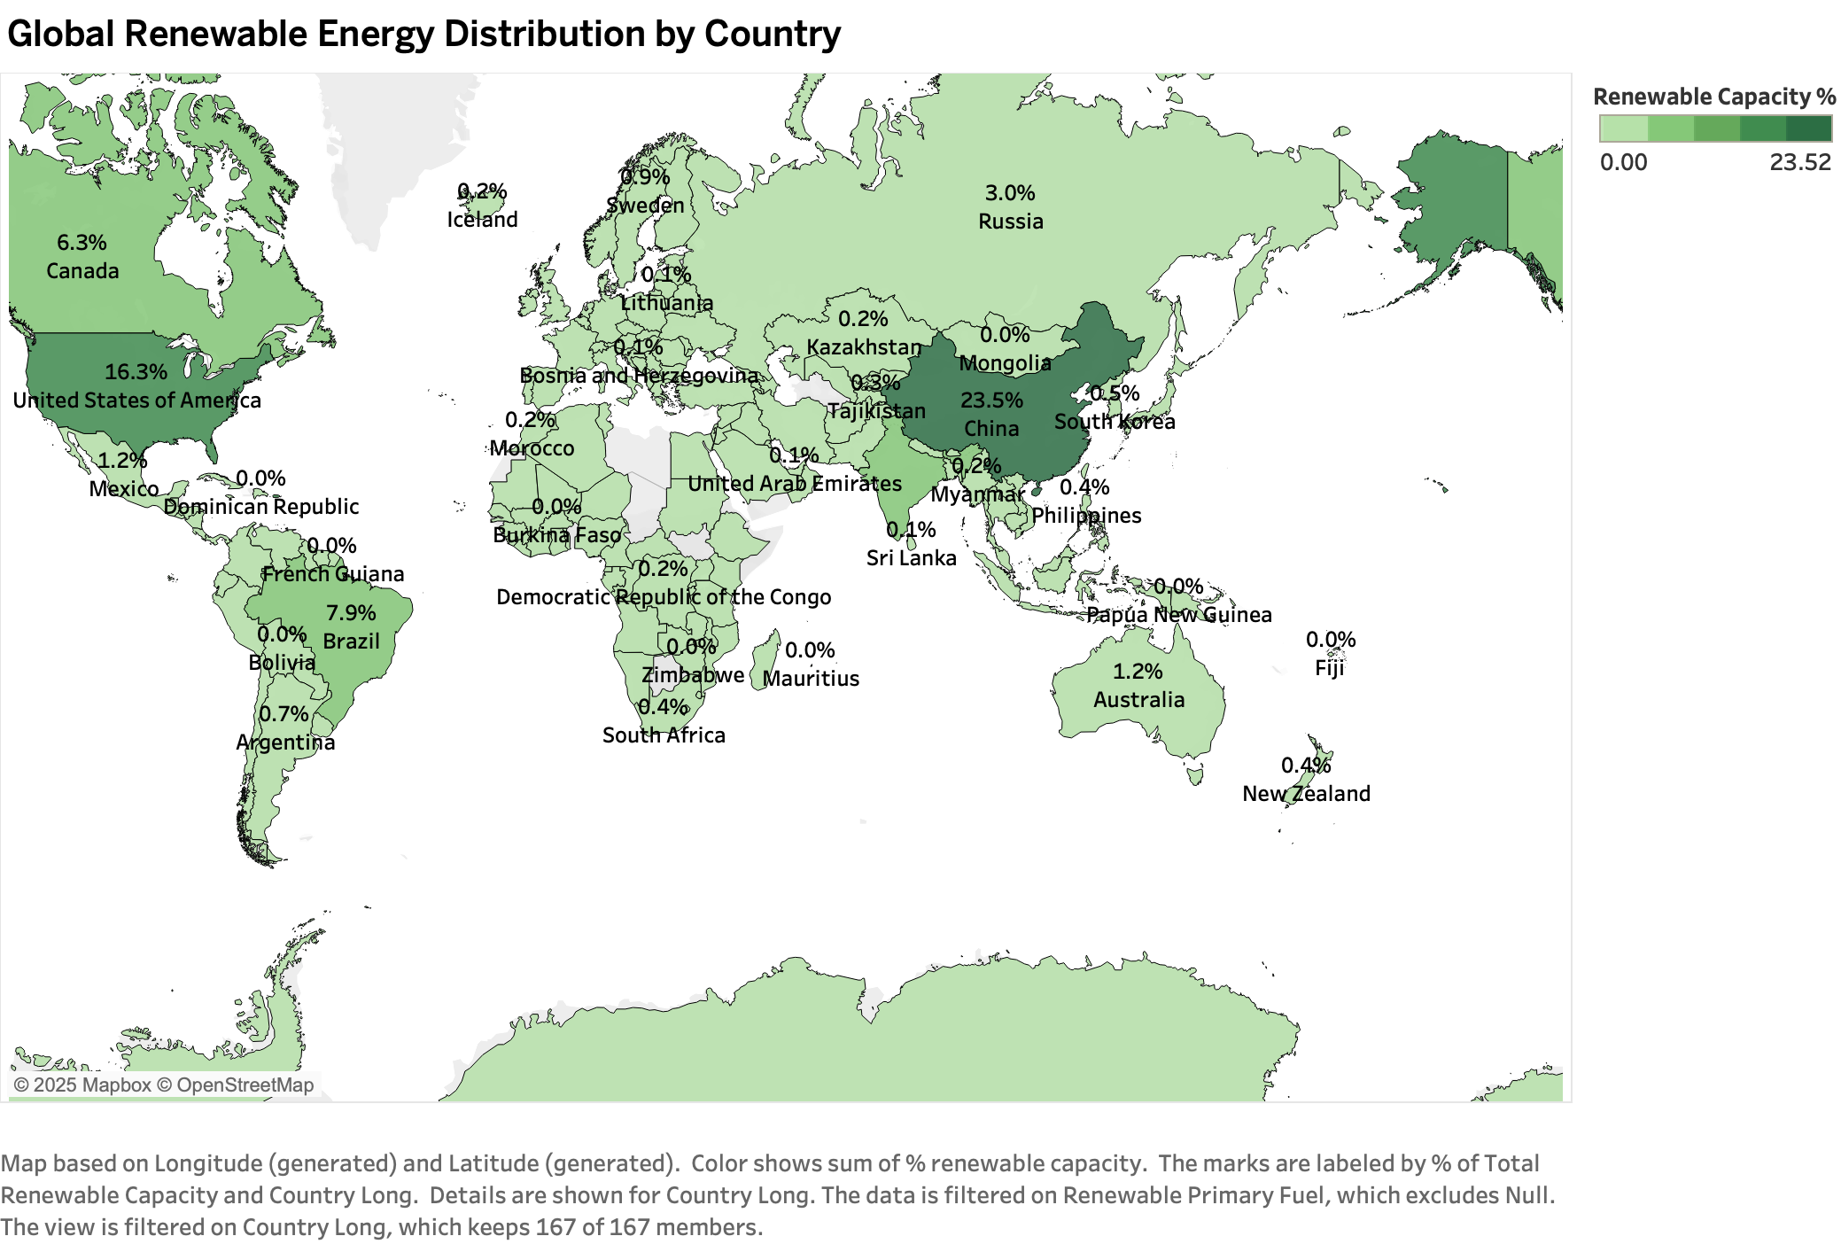

Slide 3
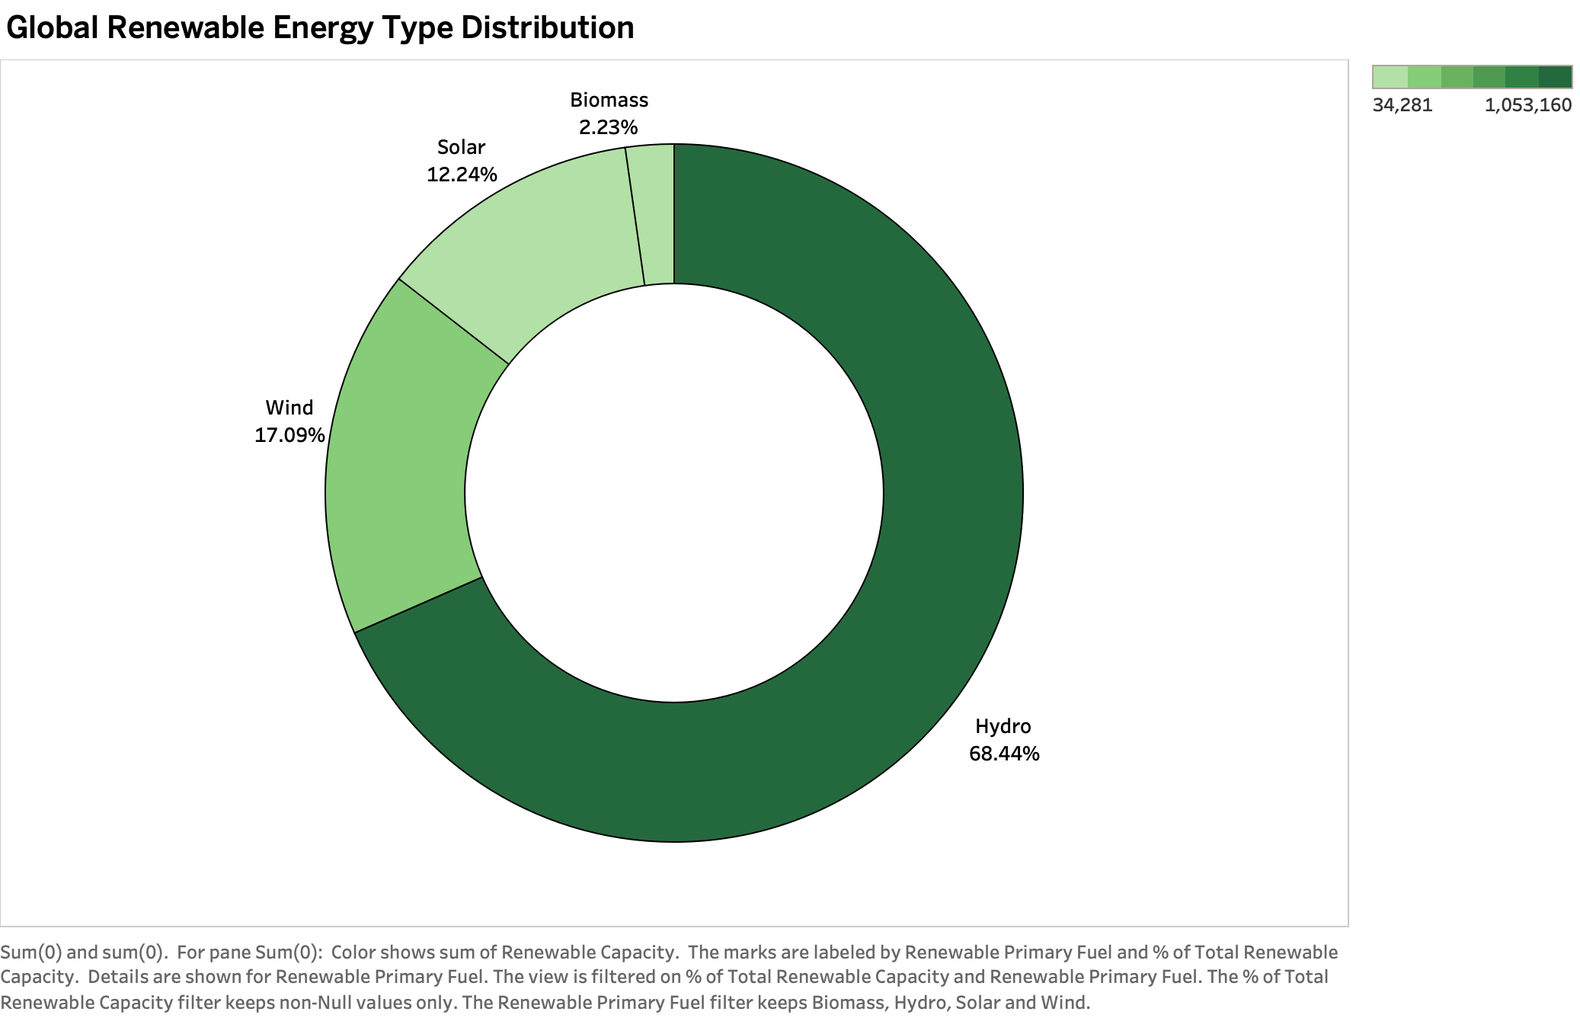

Slide 4
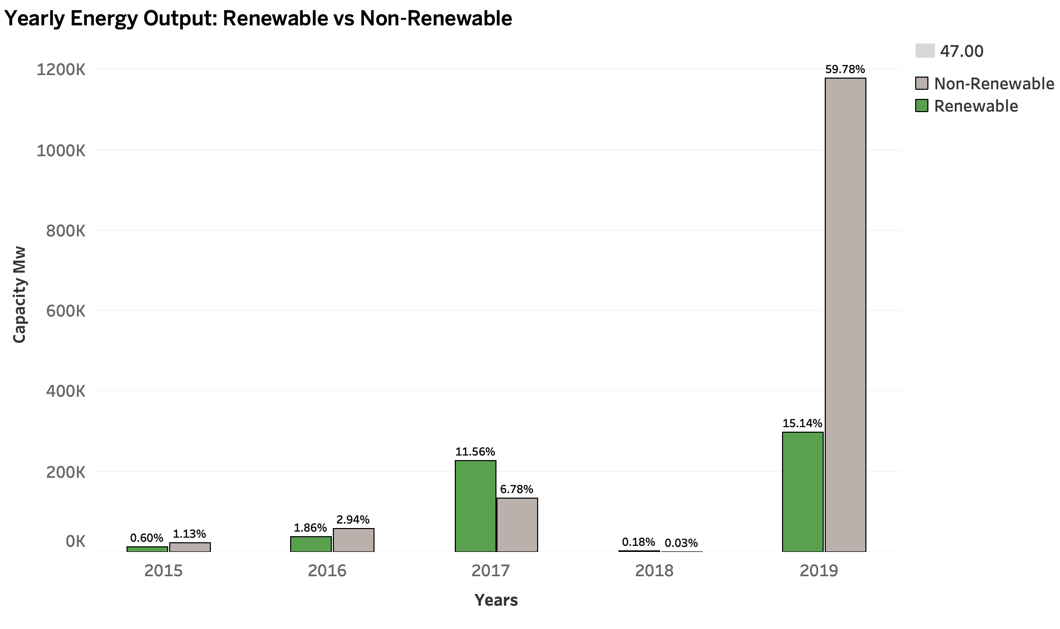

Slide 5
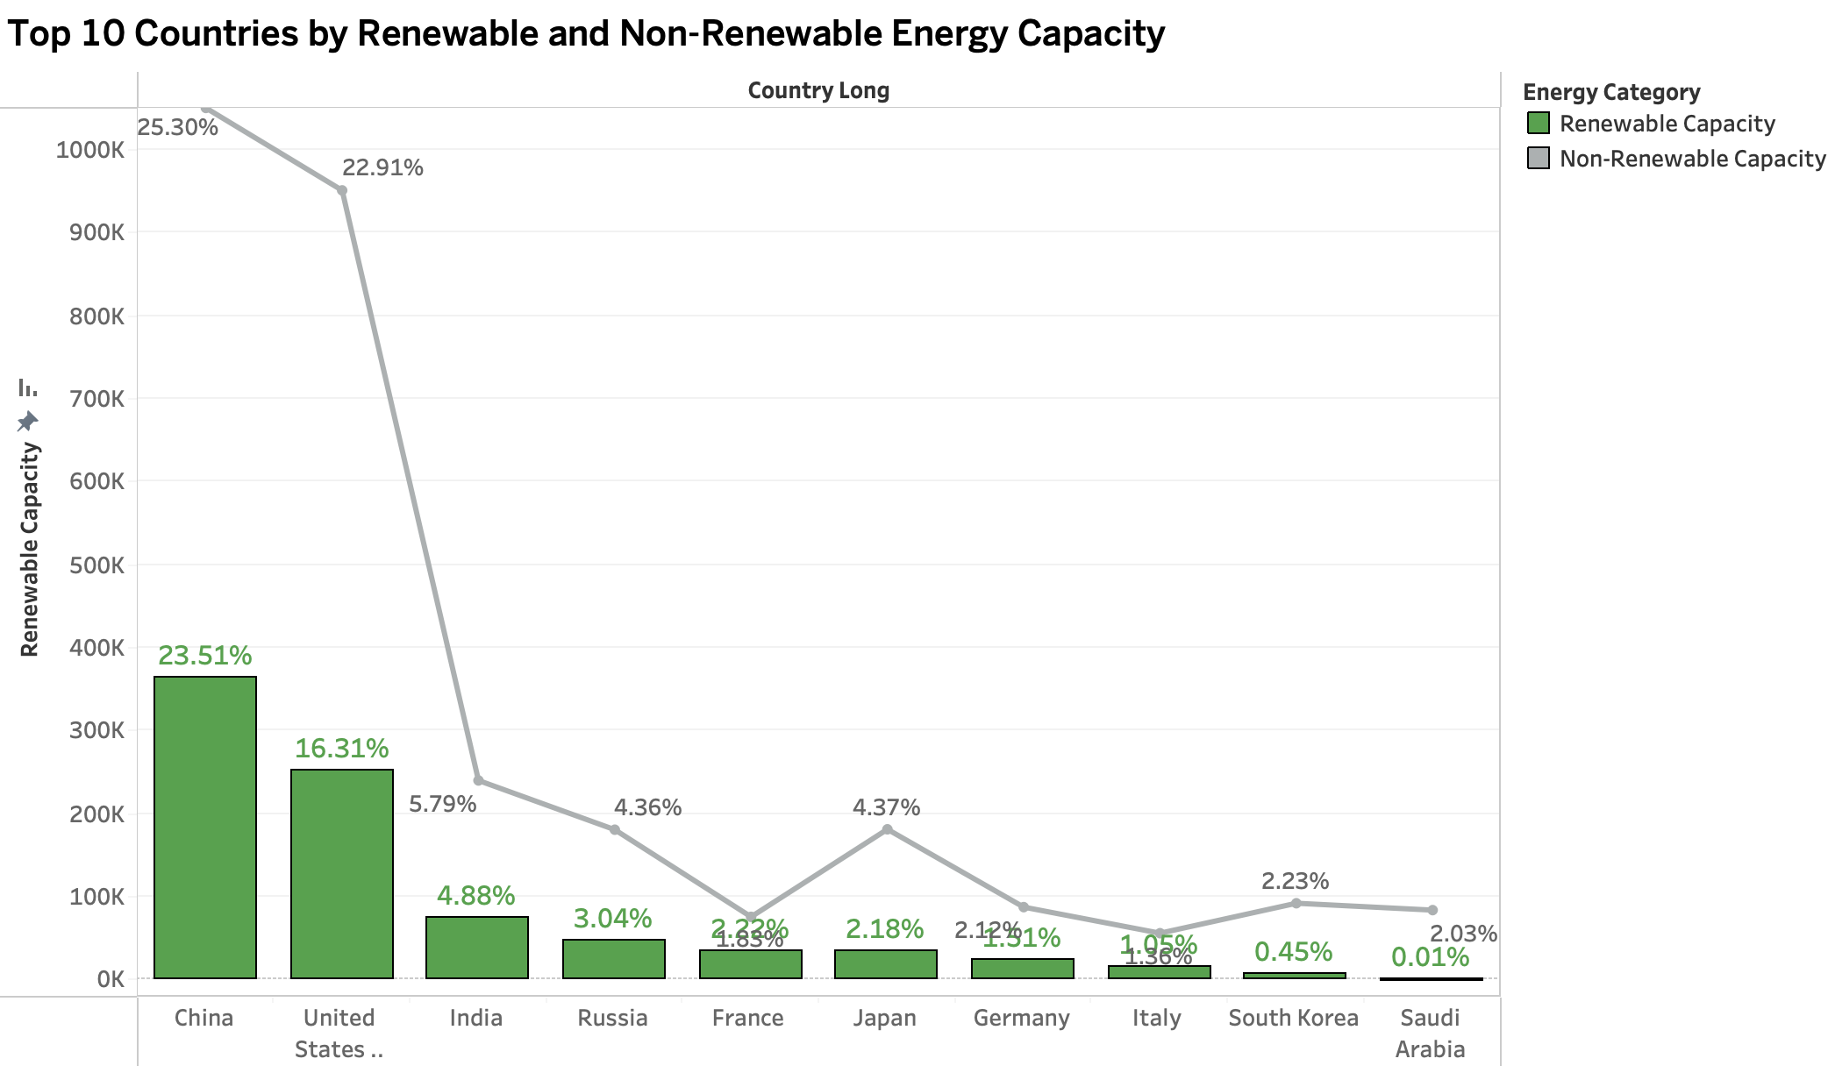

Slide 6
